Slide 1
Infinite Series Session 26-28
Course : MATH 6031 - Calculus
Year : 2021

Slide 2

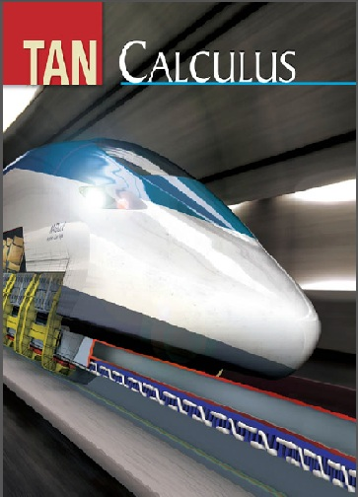
These slides have been adapted from: Dale Varberg, Edwin Purcell, Steve Rigdon. 2007. Calculus. Prentice Hall. ISBN: 978-0132306331. Soo.T.Tan. Calculus. 2010. Brooks/Cole. ISBN-13: 978-0-534-46579-7
Acknowledgement

Slide 3

Learning Objectives
LO 4:
Recognize the convergence of infinite series

Slide 4
Outline
1
Infinite Sequences
2
Infinite Series
3
Positive Series: The Integral Test
4
Positive Series: Other Tests
5
Alternating Series, Absolute Convergence, and Conditional Convergence
5
Taylor and MacLaurin series

Slide 5
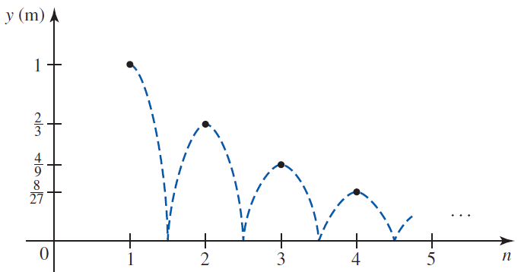
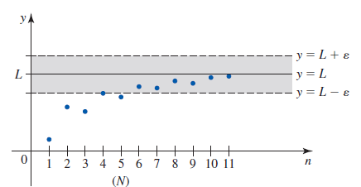
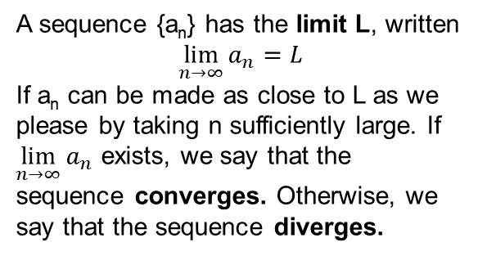
Infinite Sequences
A sequence {a_{n}} is a function whose domain is the set of positive integers. The functional values a₁, a₂, , a_{n} are the terms of the sequence, and
the term a_{n} is called the nth term of the sequence.
A sequence {a_{n}} has the limit L, written
$$\lim_{n→∞}{a_{n}=L}$$
If a_{n} can be made as close to L as we please by taking n sufficiently large. If $\lim_{n→∞}{a_{n}}$ exists, we say that the sequence converges. Otherwise, we say that the sequence diverges.

Slide 6
Example 1
Question
Does the sequence $\left\{\frac{\ln{n}}{e^{n}}\right\}$ converge and, if so, to what number?
Does the sequence {ln⁡𝑛/𝑒^𝑛 } converge and, if so, to what number?
Answer
Apply l’Hôpital’s Rule:
$$\lim_{n→∞}{\frac{\ln{n}}{e^{n}}}=\lim_{n→∞}{\frac{1/n}{e^{n}}}=0$$
Apply l’Hôpital’s Rule:
lim┬(𝑛→∞)⁡〖ln⁡𝑛/𝑒^𝑛 〗=lim┬(𝑛→∞)⁡〖(1/𝑛)/𝑒^𝑛 〗=0
Answer
That is, $\left\{\frac{\ln{n}}{e^{n}}\right\}$ converges to 0.
That is, {ln⁡𝑛/𝑒^𝑛 } converges to 0.

Slide 7
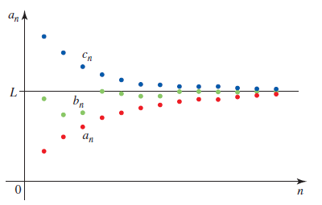


Squeeze Theorem
Theorem
Example
Show that $\lim_{n→∞}{\frac{\sin^{3}{n}}{n}}=0$
For $n≥1, −\frac{1}{n}≤$ $\frac{\sin^{3}{n}}{n}≤\frac{1}{n}$.
Since $\lim_{n→∞}{\frac{−1}{n}}=0$ and $\lim_{n→∞}{\frac{1}{n}}=0$, the result follows by the Squeeze Theorem.
If there exists some integer N such that $a_{n}≤b_{n}≤c_{n}$ for all $n≥N$and $\lim_{n→∞}{a_{n}}=\lim_{n→∞}{c_{n}}=L,$ then
$$\lim_{n→∞}{b_{n}}=L$$

Slide 8
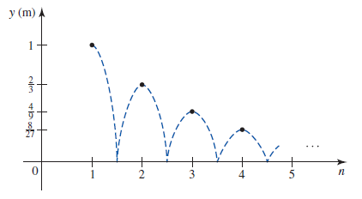


Infinite Series
An expression of the form
$a_{1}+a_{2}+a_{3}$+ …. + $a_{n}+ ….$
is called an infinite series or, more simply, a series. a_{n} is called the n-th term, or general term, of the series;
The series itself is denoted by the symbol$\sum_{n=1}^{∞}{a_{n}}$

Slide 9


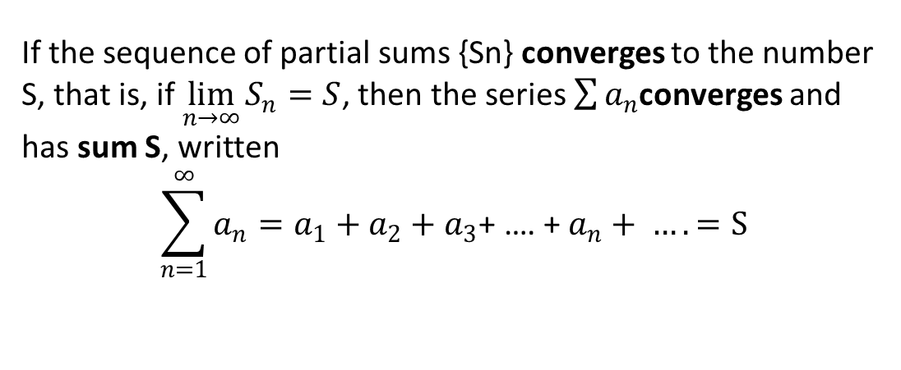
Convergence of Infinite Series
An infinite series: $\sum_{n=1}^{∞}{a_{n}}=a_{1}+a_{2}+a_{3}\text{+ …. + }a_{n}+ ….$
The n-th partial sum series: $S_{n}=\sum_{k=1}^{∞}{a_{k}}=a_{1}+a_{2}+a_{3}\text{+ …. + }a_{n}$
If the sequence of partial sums {Sn} converges to the number S, that is, if $\lim_{n→∞}{S_{n}}=S$, then the series $\sum{a_{n}}$converges and has sum S, written
$$\sum_{n=1}^{∞}{a_{n}}=a_{1}+a_{2}+a_{3}\text{+ …. + }a_{n}+ ….=S$$

Slide 10
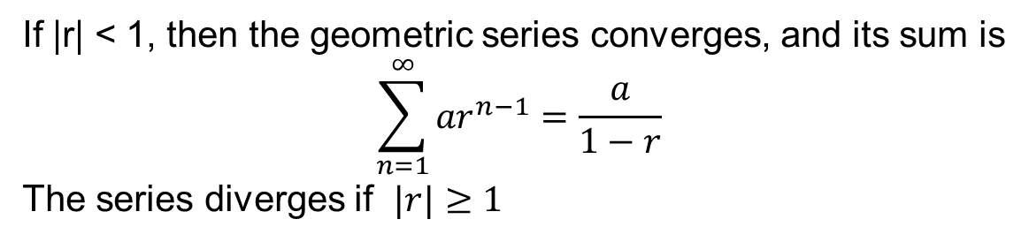
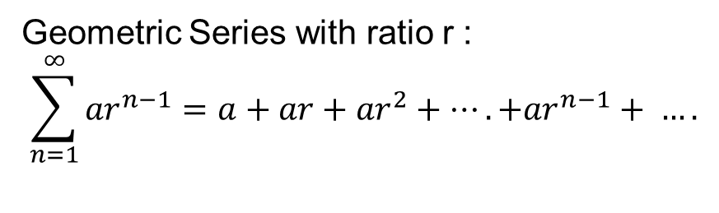
Geometric Series
Geometric Series with ratio r :
$$\sum_{n=1}^{∞}{{ar}^{n−1}}=a+ar+{ar}^{2}+….+{ar}^{n−1}+ ….$$
If |r| < 1, then the geometric series converges, and its sum is
$$\sum_{n=1}^{∞}{{ar}^{n−1}}=\frac{a}{1−r}$$
The series diverges if $|r|≥1$

Slide 11

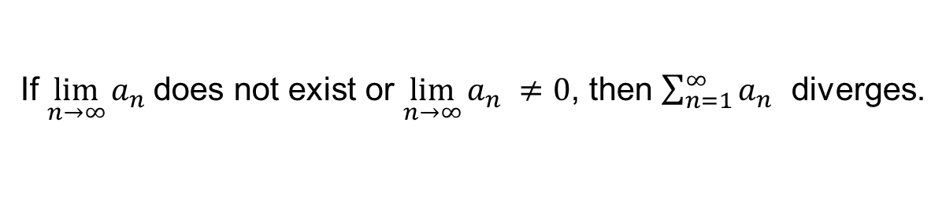
The Divergence Test
The Divergence Test
If $\lim_{n→∞}{a_{n} }$does not exist or $\lim_{n→∞}{a_{n} }≠0$, then $\sum_{n=1}^{∞}{a_{n}}$ diverges.
Example
If $a_{n}=\frac{2n^{2}+1}{3n^{2}−1}$ and $\lim_{n→∞}{\frac{2n^{2}+1}{3n^{2}−1}}=\frac{2}{3}≠0,$ then by the Divergence
Test, the series
$$\sum_{n=1}^{∞}{\frac{2n^{2}+1}{3n^{2}−1}}$$
diverges.

Slide 12
Collapsing Series
Let
$$\sum_{k=1}^{∞}{\frac{1}{(k+2)(k+3)}}$$
Let
∑24_(𝑘=1)^∞▒1/((𝑘+2)(𝑘+3))
Use a partial fraction decomposition to write
$$\frac{1}{(k+2)(k+3)}$$
$$=\frac{1}{k+2}−\frac{1}{k+3}$$
Use a partial fraction decomposition to write
1/((𝑘+2)(𝑘+3))
=1/(𝑘+2)−1/(𝑘+3)
$$S_{n}=\sum_{k=1}^{∞}{\frac{1}{k+2}−\frac{1}{k+3}}$$
$$=\left(\frac{1}{3}−\frac{1}{4}\right)+\left(\frac{1}{4}−\frac{1}{5}\right)$$
$$+…+\left(\frac{1}{n+2}−\frac{1}{n+3}\right)$$
$$=\frac{1}{3}−\frac{1}{n+3}$$
𝑆_𝑛=∑_(𝑘=1)^∞▒〖1/(𝑘+2)−1/(𝑘+3)〗
=(1/3−1/4)+(1/4−1/5)
+…+(1/(𝑛+2)−1/(𝑛+3))
=1/3−1/(𝑛+3)
Therefore, $\lim_{n→∞}{S_{n}}=\frac{1}{3}$. The series converges and has sum $\frac{1}{3}$

Slide 13
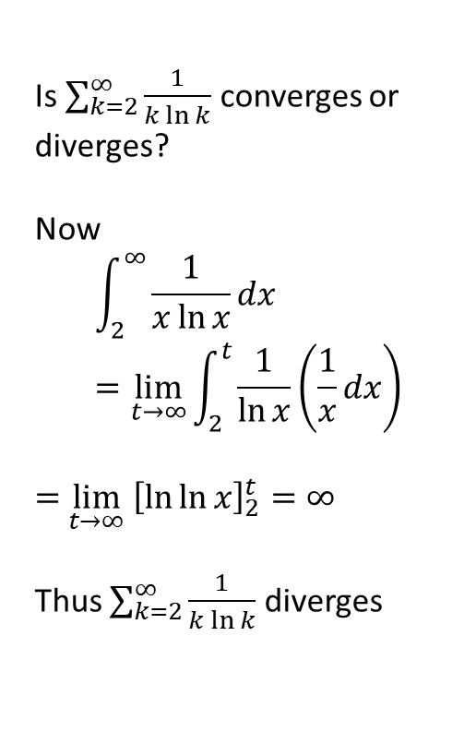

Integral Test
Theorem Example
Let f be a continuous, positive, nonincreasing function on the interval $[1,∞)$ and suppose that $a_{k}=f\left(k\right)$ for all positive integers k. Then the infinite series
$$\sum_{k=1}^{∞}{a_k}$$
converges if and only if the improper integral
$$\int_{1}^{∞}{f\left(x\right)dx}$$
converges.
Is $\sum_{k=2}^{∞}{\frac{1}{k\ln{k}}}$ converges or diverges?
Now
$$\int_{2}^{∞}{\frac{1}{x\ln{x}}dx}=\lim_{t→∞}{\int_{2}^{t}{\frac{1}{\ln{x}}\left(\frac{1}{x}dx\right)}}$$
$=$ $\lim_{t→∞} {\left[\ln{\ln{x}}\right]}_{2}^{t}=∞$
Thus $\sum_{k=2}^{∞}{\frac{1}{k\ln{k}}}$ diverges

Slide 14
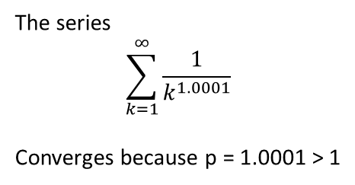

p-Series Test
p-Series Test
Example
The series
$$\sum_{k=1}^{∞}{\frac{1}{k^{p}}=1+\frac{1}{2^{p}}+\frac{1}{3^{p}}}+…$$
where $p$ is a constant, is called a p
series.
(a) The p-series converges if $p>1$
(b) The p-series diverges if $p≤1$
The series
$$\sum_{k=1}^{∞}{\frac{1}{k^{1.0001}}}$$
Converges because p = 1.0001 > 1

Slide 15
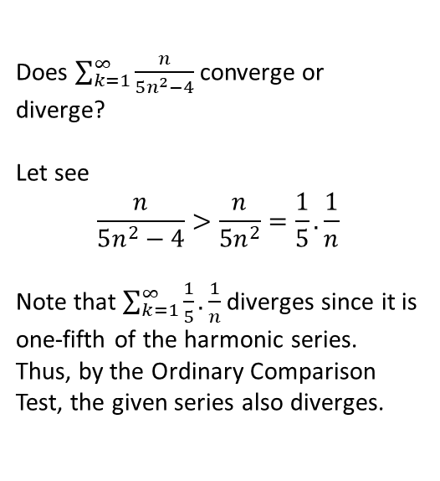

Ordinary Comparison Test
Does $\sum_{k=1}^{∞}{\frac{n}{5n^{2}−4}}$converge or diverge?
Let see
$$\frac{n}{5n^{2}−4}>\frac{n}{5n^{2}}=\frac{1}{5}.\frac{1}{n}$$
Note that $\sum_{k=1}^{∞}{\frac{1}{5}.\frac{1}{n}}$ diverges since it is one-fifth of the harmonic series. Thus, by the Ordinary Comparison Test, the given series also diverges.
Suppose that $0≤a_{n}≤b_{n}$ for $n≥N$
(i) If $∑b_{n}$ converges, so does $∑a_{n}$
(ii) If $∑a_{n}$ diverges, so does $∑b_{n}$
Theorem
Example

Slide 16
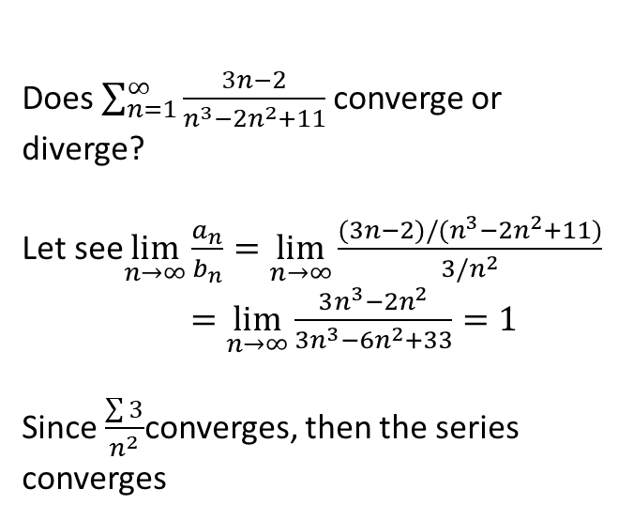

Limit Comparison Test
Does $\sum_{n=1}^{∞}{\frac{3n−2}{n^{3}−2n^{2}+11}}$converge or diverge?
Let see$\lim_{n→∞}{\frac{a_{n}}{b_{n}}}=\lim_{n→∞}{\frac{(3n−2)/(n^{3}−2n^{2}+11)}{3/n^{2}}}$
$=\lim_{n→∞}{\frac{3n^{3}−2n^{2}}{3n^{3}−6n^{2}+33}}=1$
Since $\frac{\sum{3}}{n^{2}}$converges, then the series converges
Suppose that $a_{n}≥0, b_{n}≥0$ and
$$\lim_{n→∞}{\frac{a_{n}}{b_{n}}}=L$$
If $0<L<∞$ then $∑a$ and $∑b_{n}$ converge or diverge together.
If L = 0 and $∑b_{n}$ converges, then $∑a_{n}$ converges
Theorem
Example

Slide 17


Ratio Test
Test for convergence or divergence
$$\sum_{n=1}^{∞}{\frac{2^{n}}{n^{20}}}$$
Let see
$$ρ=\lim_{n→∞}{\frac{a_{n+1}}{a_{n}}}=\lim_{n→∞}{\frac{2^{n+1}}{{\left(n+1\right)}^{20}}.\frac{n^{20}}{2^{n}}}$$
$=\lim_{n→∞}{{\left(\frac{n}{n+1}\right)}^{20}.2}=2$
We conclude that the given series diverges.
Let $∑a_{n}$ be a series of positive terms and suppose that
$$\lim_{n→∞}{\frac{a_{n+1}}{a_{n}}}=ρ$$
(i). If $ρ<1$ the series
converges.
(ii) If $ρ>1$the series diverges.
(iii) If $ρ = 1$, the test is
inconclusive.
Theorem
Example

Slide 18


Alternating Series Test
Theorem Example
Let
$$a_{1} −a_{2}+a_{3}−a_{4}+ ….$$
be an alternating series with
$a_{n}>a_{n+1}>0$.
If $\lim_{n→∞} a_{n}=0,$ then the series converges.
Moreover, the error made by using the sum $S_{n}$ of the first n terms to approximate the sum S of the series is not more than $a_{n+1}$.
The alternating harmonic series
$$1−\frac{1}{2}+\frac{1}{3}−\frac{1}{4}+…$$
converges because
$$\lim_{n→∞} a_{n}=\lim_{n→∞}\frac{1}{n}=0$$

Slide 19


Absolute Ratio Test
Theorem Example
Let $∑u_{n}$ be a series of nonzero terms and suppose that
$$\lim_{n→∞}{\frac{|u_{n+1}|}{|u_{n}|}}=ρ$$
(i). If $ρ<1$ the series
converges absolutely.
(ii). If $ρ>1$the series
diverges.
(iii) If $ρ = 1$, the test is
inconclusive.
Show that
$$\sum_{n=1}^{∞}{{\left(−1\right)}^{n+1}\frac{3^{n}}{n!}}$$
converges absolutely.
$$ρ=\lim_{n→∞}{\frac{|u_{n+1}|}{|u_{n}|}}=\lim_{n→∞}{\frac{3^{n}}{n!}}=\lim_{n→∞}{\frac{3}{n+1}}=0$$

Slide 20

Power Series in x-a
A series of the form
$$\sum_{n=0}^{∞}{a_{n}{(x−a)}^{n}}=a_{0}+a_{1}(x−a)+a_{2}({x−a)}^{2}+….$$
is called a power series in x-a
In particular, its convergence set is always one of the following kinds of intervals:
1. The single point x = a
2. An interval (a - R, a + R), plus possibly one or both end points 3. The whole real line.

Slide 21
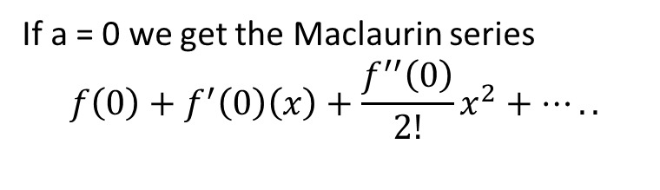
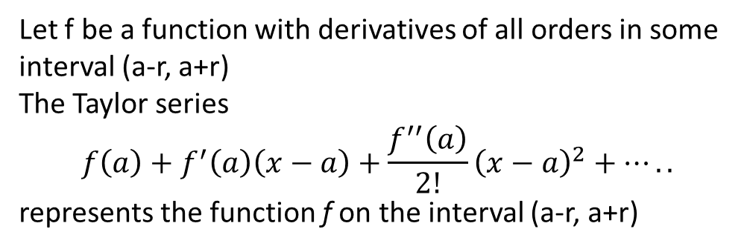
Taylor’s Formula
Let f be a function with derivatives of all orders in some interval (a-r, a+r)
The Taylor series
$$f\left(a\right)+f^{′}\left(a\right)\left(x−a\right)+\frac{f^{′′}\left(a\right)}{2!}{\left(x−a\right)}^{2}+…..$$
represents the function f on the interval (a-r, a+r)
Taylor series
If a = 0 we get the Maclaurin series
$$f\left(0\right)+f^{′}\left(0\right)\left(x\right)+\frac{f^{′′}\left(0\right)}{2!}x^{2}+…..$$
Maclaurin series

Slide 22
Example
Find the Maclaurin series for sin x and prove that it represents sin x for all x.
f(x) = sin x
f’(x) = cos x
f’’(x) = -sin x
f’’’(x) = - cos x
f(0) = 0
f’(0) = 1
f’’(0) = 0
f’’’(0) = - 1

Slide 23
The Taylor Polynomial
1
The Taylor Polynomial of Order 1:
2
The Taylor Polynomial of Order n :
3
Taylor polynomial of order n based at a:

Slide 24
Maclaurin Polynomials
Taylor polynomial
a = 0
Maclaurin polynomial of order n, which gives a particularly useful approximation near x = 0:
$$f\left(x\right)≈P_{n}\left(x\right)=f\left(0\right)+f^{′}\left(0\right)\left(x\right)+\frac{f^{′′}\left(0\right)}{2!}x^{2}+…+\frac{f^{n}\left(0\right)}{n!}x^{n}$$
Maclaurin polynomial of order n, which gives a particularly useful approximation near x = 0:
𝑓(𝑥)≈𝑃_𝑛 (𝑥)=𝑓(0)+𝑓^′ (0)(𝑥)+(𝑓^′′ (0))/2! 𝑥^2+…+(𝑓^𝑛 (0))/𝑛! 𝑥^𝑛

Slide 25
Dale Varberg, Edwin Purcell, Steve Rigdon. 2007. Calculus. Prentice Hall. ISBN: 978-0132306331.
Dale Varberg, Edwin Purcell, Steve Rigdon. 2014. Calculus Early Transcendentals. Pearson New International Edition. ISBN: 978-1-292-04268-8
Soo.T.Tan. 2010. Calculus. Brooks/Cole. ISBN-13: 978-0-534-46579-7

